Slide 1

Using AI to Create Structured Data
In a Lights-Out Automation Environment

Slide 2

Intelligent data transformation
DCL provides data and content transformation services and solutions. Using the latest innovations in artificial intelligence, including machine learning and natural language processing, DCL helps businesses organize and structure content/data for modern technologies and platforms.
Your data—
transformed, validated, enriched.

Slide 3























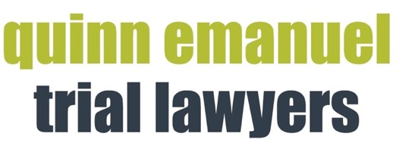



Representative Customers
FINANCIAL
LEGAL
TECHNICAL
DOCUMENTATION
DEFENSE
GOVERNMENT
PHARMA
LIBRARIES
PUBLISHING

Slide 4

DATA CHALLENGE

Slide 5

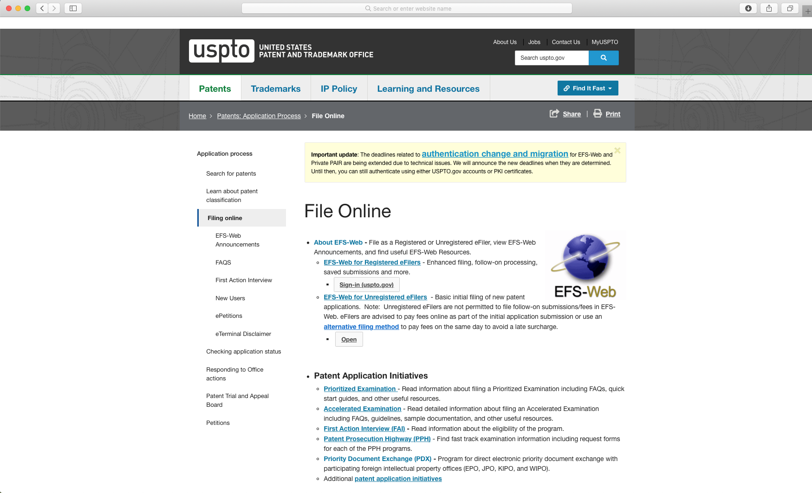

The United States Patent and Trademark Office
“
We have a remarkable patent system, born of our Constitution and steeped in our history. We have a unique opportunity to ensure it meets its full constitutional mandate to promote innovation and grow our economy.
- DIRECTOR ANDREI IANCU
Speech at the American Enterprise Institute

Slide 6
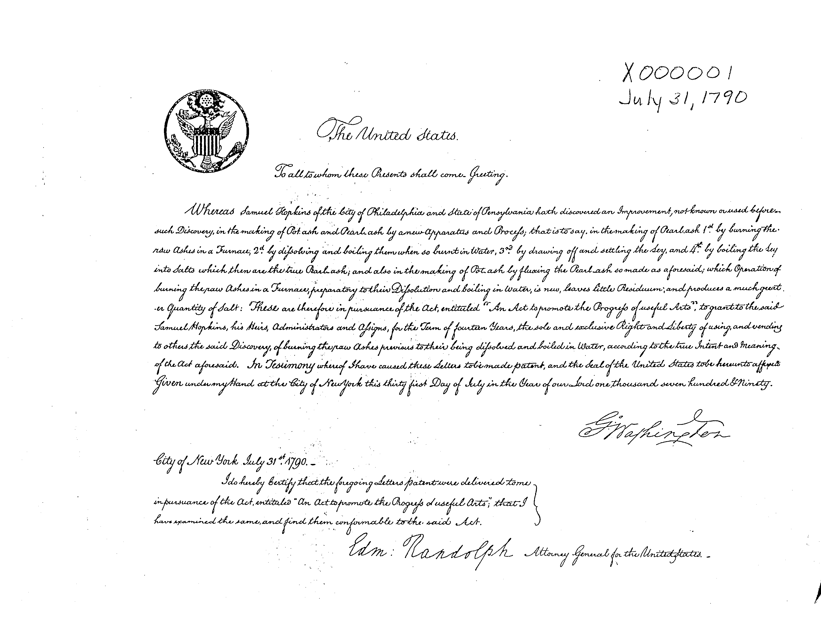
The First Patent

Slide 7
Patents Over the Years
121 years
1911
1935 | 24 years
1911
1961 | 26 years
1976 | 15 years
1935
1991 | 15 years
1999 | 8 years
2006 | 7 years
2011 | 5 years
2015 | 4 years
2018 | 3 years
Notes:
Cover footer

Slide 8




Key Project Attributes
Security
High-Volume
Cost & Complexity
Turnaround Time
Required a secure, cost-effective solution to transform backlog and ongoing patent applications into structured data points. Unpublished patents are confidential.
USPTO processes a continuous flow of 5,000,000 page images and PDF pages per month. Data is unstructured, not AI-ready.
Complex unorganized information with images, equations, form content, and more. Processing confidential content required a system with zero human intervention, at a very low cost.
Data turnaround time requirement was ≤4 hours (current average ~ 10 mins). System had to run 24/7 in a lights-out automated manner.

Slide 9
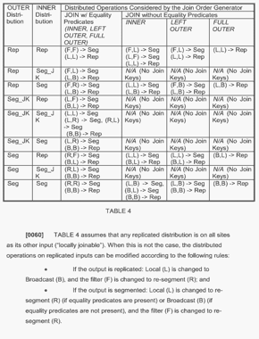
Highly Variable and Complex Content
Narrative Page
Unstructured text
Chemical structures
Line numbers
Headers & footers
Table Narrative
Tables with subheadings
Straddle headings
Mathematical formulae
Forms
Hundreds of variations
Fields & inserted text
Line numbering
Headings
Hybrid Form
Form with narrative text
Data fields
Time stamps
Signatures

Slide 10

IT’S NOT AS SIMPLE AS TURNING ON THE LIGHT

Slide 11
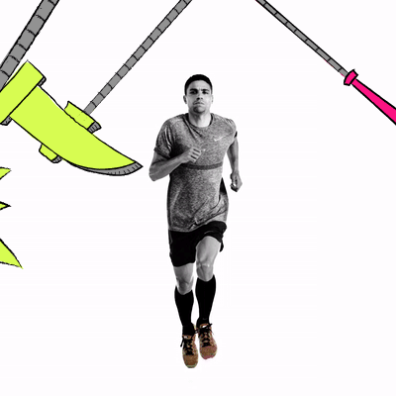
Key Workflow Steps
24/7 SaaS production 2M+ pages/month Lights-out automation
Computer vision analytics
Artifact extraction
OCR
Natural Language Processing
Algorithmic data detection
XML construction
Metadata extraction
Quality validation

Slide 12
Natural Language Processing - Semantic Analysis
“Read,” “understand,” and contextually structure complex technical text buried in free-form content.
Source text
Fully tagged with the Part Names and Numbers
FIG. 6 illustrates a diagram of the signal adaptive pre-filter 1200 and motion detector 1300 section within the segmented temporal processor 1400.
<para>FIG. 6 illustrates a diagram of the <part-name>signal adaptive pre-filter</part-name> <part-number>1200</part-number> and <part-name>motion detector</part-name> <part-number>1300</part-number> section within the <part-name>segmented temporal processor</part-name> <part-number>1400</part-number>. </para>
Stanford NLP engine
Princeton WordNet Lexical Database
Open Parser for Systemic IUPAC nomenclature (OPSIN), USPTO CPC, NIH MESH
Technologies & Resources

Slide 13
Rules-based Algorithms – Claim Documents
Semantic tagging to distinguish certain attributes, tag cross-references, and dependencies.
Source text
Tagged
2. (Original) The method of claim 1, wherein the mixed analog audio signal is transmitted to the terrestrial uplink device using a radio frequency connection.
<Claim>id=CLM00002 <ClaimNumber>2</ClaimNumber><ClaimText>
<ClaimLabelText>2.</ClaimLabelText> (Original) The method of claim <ClaimReference>1CLM-00001</ClaimReference>, wherein the mixed analog audio signal is transmitted to the terrestrial uplink device using a radio frequency connection.
<ClaimStatusCategory>original</ClaimStatusCategory>
<ClaimTypeCategory>Dependent</ClaimTypeCategory></ClaimText</Claim>
Lexical analysis
Syntactical Analysis
Regular Expressions
Pattern Recognition
OCR Recovery
Techniques

Slide 14
Built for Scalability: Parallel Computing Stack
Confidential
High volume
DCL Inbox
USPTO
LOAD BALANCING
Receive & Validate Transmission
Receive & Validate Transmission
Receive & Validate Transmission
Lights-out automation
Scalable
Unlimited volume
Secure system boundary (NIST 800.53)
CV Analytics
CV Analytics
CV Analytics
Artifact Extraction
Artifact Extraction
Artifact Extraction
OCR
OCR
OCR
NLP & Algorithmic Data Classification
NLP & Algorithmic Data Classification
NLP & Algorithmic Data Classification
Construct XML
Construct XML
Construct XML
QA Validation
QA Validation
QA Validation
USPTO Outbox

Slide 15

Business Results for USPTO
Deeper understanding of patent submissions
Increased productivity
Faster, more accurate patent review
Structured, extendable data
Improved usability
Faceted search
Discoverability
Quantitative data analysis

Slide 16

MORE AI INITIATIVES
16

Slide 17


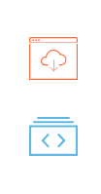
Website Data Harvesting & AI Transformations
Global Financial Institution
Business Challenge
Accurately monitor, harvest and deliver legal, regulatory, and compliance management data for hundreds of jurisdictions.
Harmonize and structure content for downstream systems.
Technologies
HTML Agility Pack
C#
GATE/JAPE
Lucene Tokenizer
Google TensorFlow
JAVA
PERL
DCL Solution
Methodology for custom, SME analysis of websites.
Daily robotic scans of ~150 websites.
Harvest new and modified content (PDF, HTML, XML, RTF, Word).
Analyze, cleanse, and harmonize data.
Provide cross-reference linking.
Convert to XML schema for delivery.
Business Metrics
150+ websites
1000s content types
Results
Streamlined-informed compliance processes
Provide risk avoidance.
Growing repository of legal documents with daily highlights of new and updated content.

Slide 18
Entity Extraction Using AI
STM Commercial Publisher
The grant organization, grant number and recipient must be located and extracted from the free-text, using regular expressions:
<ce:section-title id="st040">Acknowledgments</ce:section-title><ce:para id="p0255">This work was supported by grants of Saint Petersburg State University (11.38.271.2014 and 15.61.202.2015), Russian Foundation for Basic Research (RFBR) projects (Project No. 13-02-91327) and was performed in the framework of a collaboration between the Deutsche Forschungsgemeinschaft and RFBR (RA 1041/3-1). The authors acknowledge support from Russian–German laboratory at BESSY II, the program “German–Russian Interdisciplinary Science Center” (G-RISC) and the Resource Center of Saint-Petersburg State University “Physical Methods of Surface Investigation”.</ce:para>
Business Challenge
Critical funding information was buried in free-form text.
Publisher required funding-related text extraction and structured content to
  support data analytics
  funding reporting
  improved search
  bolster other business functions
<funding-group>
<award-group id=”SPSU"> <funding-source country=”Russia">Saint Petersburg State University</funding-source>
<award-id>11.38.271.2014</award-id>
<award-id>15.61.202.2015</award-id> </award-group> </funding-group>
<funding-group> <award-group id=”RFBR"> <funding-source country=”Russia">Russian Foundation for Basic Research</funding-source> <award-id>13-02-91327</award-id> </award-group> </funding-group>
DCL Solution
Built data sets for supervised machine learning.
Developed and trained a series of machine learning/NLP, pattern detection, and statistical algorithms and models.
Applied algorithms and models to auto-identify and extract grant content from free-form and structured text.
Machine Learning
NLP engines
Text analysis
Technologies

Slide 19
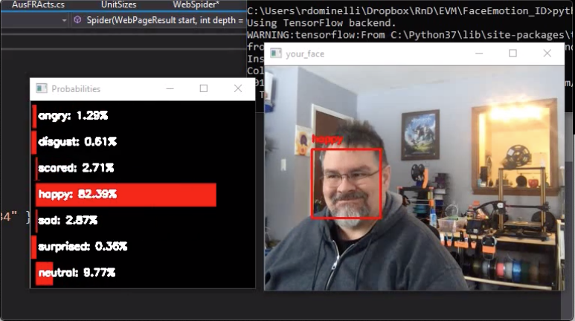
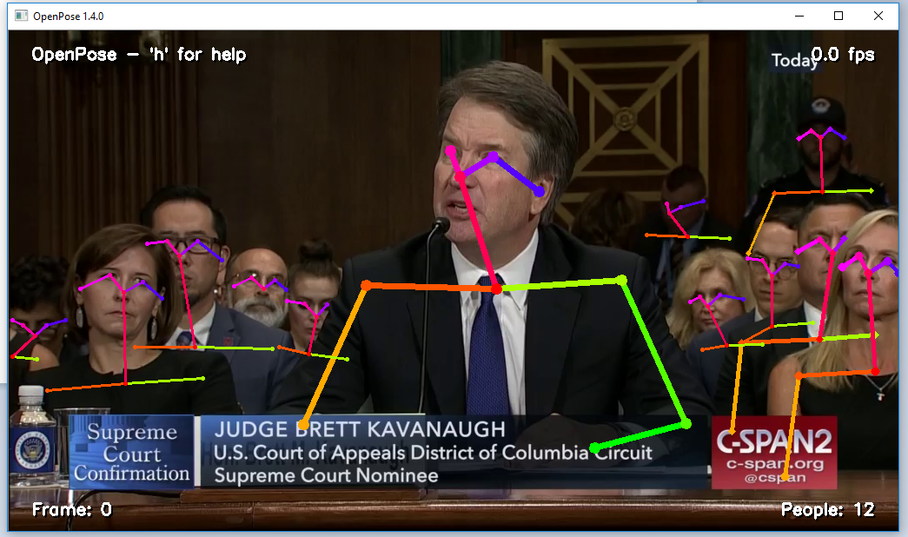
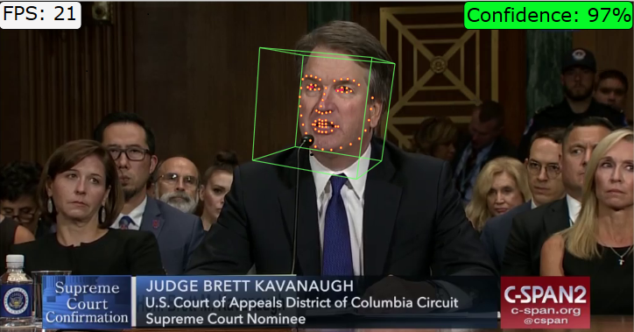
Data-Driven Facial and Body Analysis
Transforming emotions to a data-driven readable form; focused on changes in subject stress levels
Paired several eulerian video-enhancement detectors:
  facial recognition
  body pose estimators
  micro-expression (emotions)
  pulse rate measurement
to report on detectable body changes
Python
OpenCV
Machine Learning models
Technologies

Slide 20
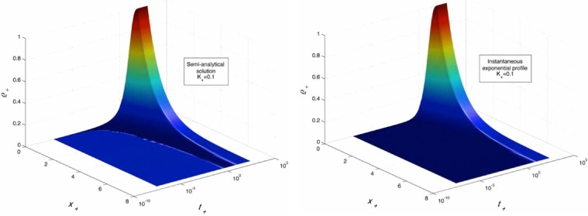
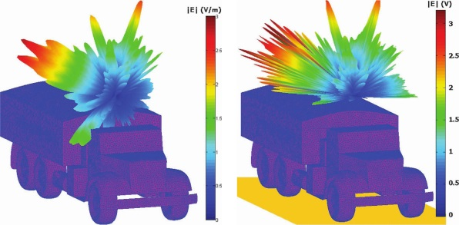
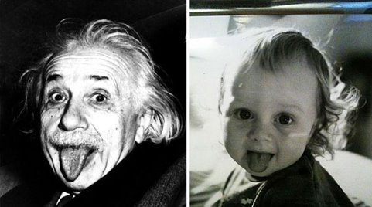
Image Plagiarism Detection: Arbitrary Subjects/Big Data
Nearly identical images: perceptual difference score = 2
Created image database & user interface –
load, hash and compare images
Compensate for image transformations – rescaling, occlusion, color remapping, cropping, rotation, etc.
Employ various perceptual hash functions to convert the same image to different strings
  Average hash function
  Difference hash function
  Discrete cosine transform (color data)
Each function has its strengths and weaknesses
Use several functions for productive comparison
Somewhat dissimilar images with similar color scheme: perceptual difference score = 20
0000000000000000001110001111100011111100111111000111111000010010

Slide 21
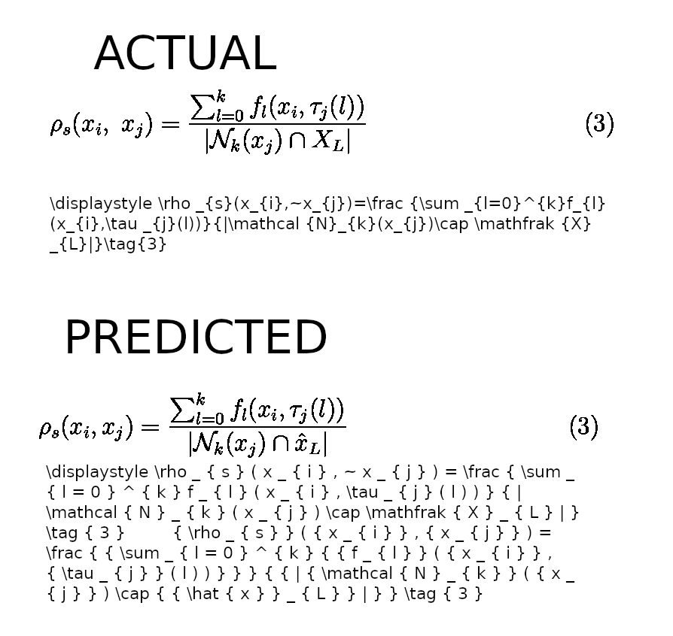

Supervised Machine Learning – From Image to Markup
A deep-learning system to transform images into markup, e.g. LaTeX
Here’s the actual equation
Created training data leveraging decades of XML content creation - ~50K images/markup pairs.
Built validation tool for highly-accurate training data.
Selected and trained the Harvard NLP Image to Markup Model, raising accuracy from 4% to 70%.
Model employs a convolutional network (feature recognition) for text and layout, with an attention-based neural machine translation system.
Successfully transformed images to LaTex math.
Here’s the predicted equation
Inspired by

Slide 22

Go Where Your Organization Has Not Gone Before!
AI enables organizations to revisit high-value, but previously impractical, high-cost projects
Ongoing transformation
Iterate and extract intelligence from previously digitized content (including paper, images, PDF).
Achieve more than was feasible before!
automated
FEEDS
Complex data
complex
Variable data (or content) types with special characters, math, chemical formulae, etc.
New levels of accuracy now possible with computer vision.
DATA
Security and automation
security
Cost-effective solutions that deals with confidential or sensitive data.
New AI techniques provide capabilities previously impossible.
BUDGET
ARTIFICIAL
INTELLIGENCE Transforms

Slide 23

Questions?
DCL structures the world’s data to make it consumable.
Tammy Bilitizky
Chief Information Officer
DCL
+1.718.307.5708
tbilitizky@dclab.com
Address
Brooklyn street, 123
https://www.linkedin.com/company/dclab/
@DCLaboratory

